Slide 1
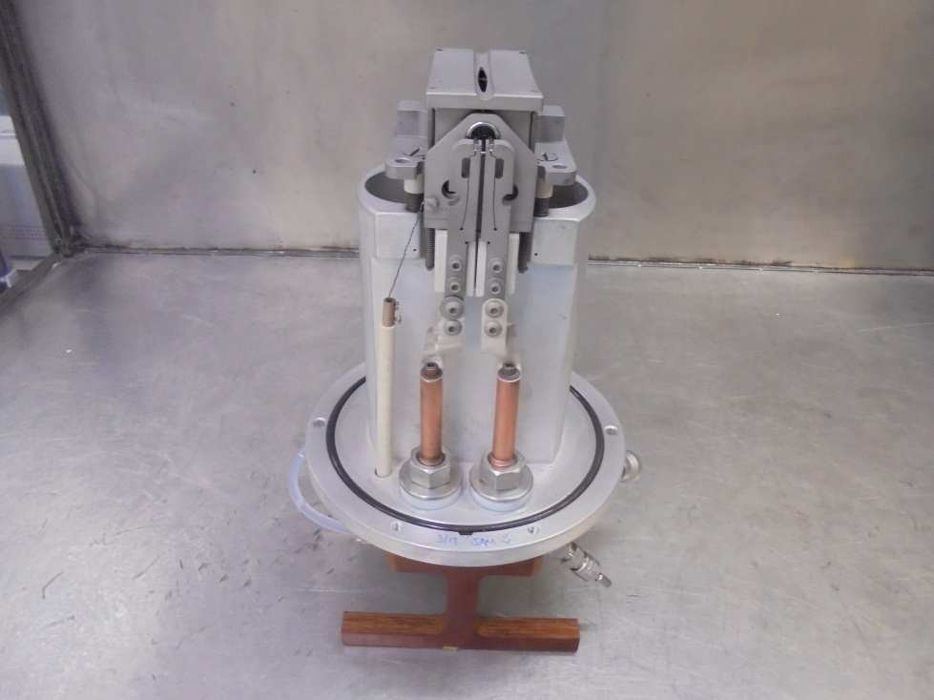
第三次新人週報
工號:1200106
姓名:黃劭宸
到職日:109/03/30

Slide 2
GSD 200 SOURCE HEAD
DISMANTLING
ASSEMBLE
ISOLATION TEST
引用自SAMUEL - 山姆爾的GSD 200 SOURCE HEAD Maintenance Guideline

Slide 3
DISMANTLING
OF COMPONENTS

Slide 4
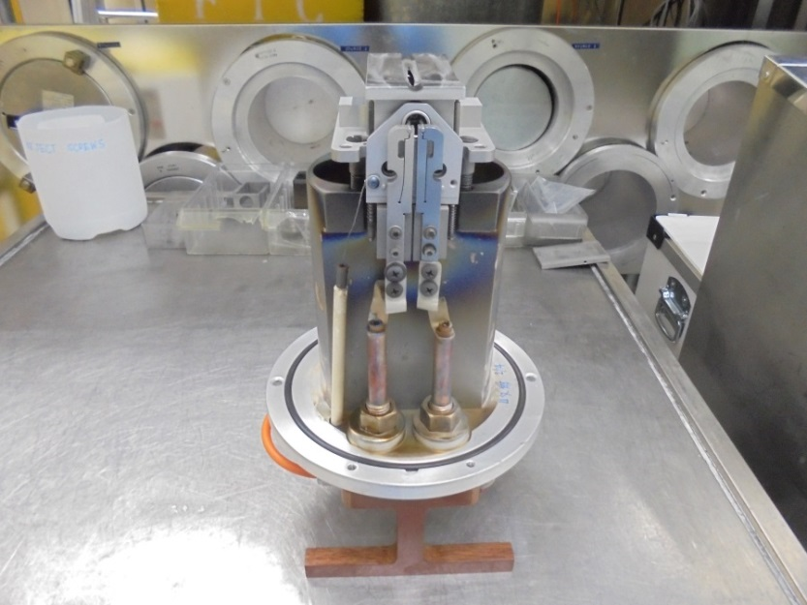
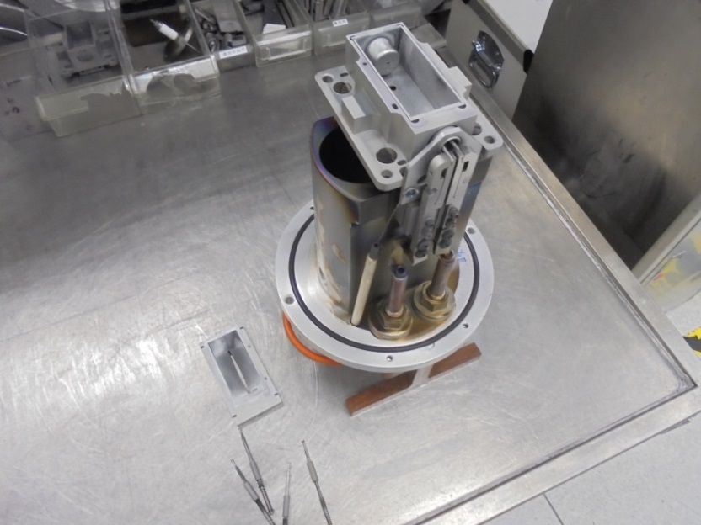
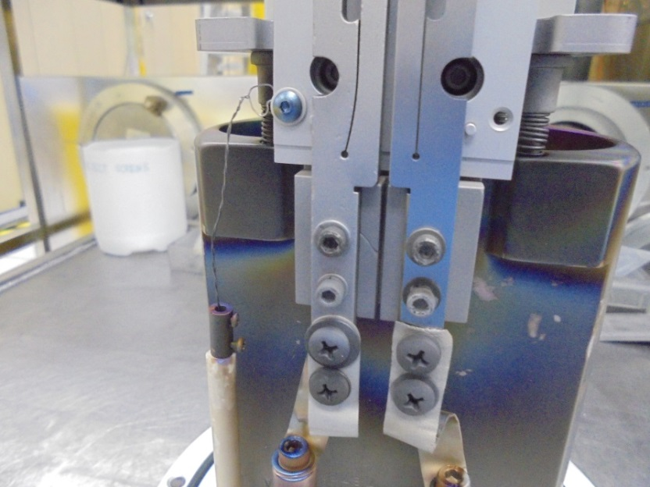
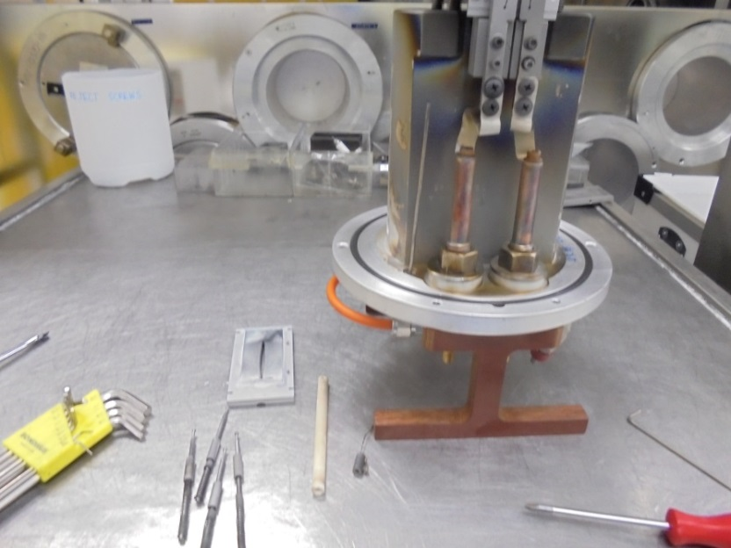
1
2
移除四根RETAIN PIN
移除ARC SLIT
3
4
鬆開螺絲讓CATHODE WIRE 跟CATHODE SUPPORT PLATE分離
移除CERAMIC CATHODE TUBE

Slide 5
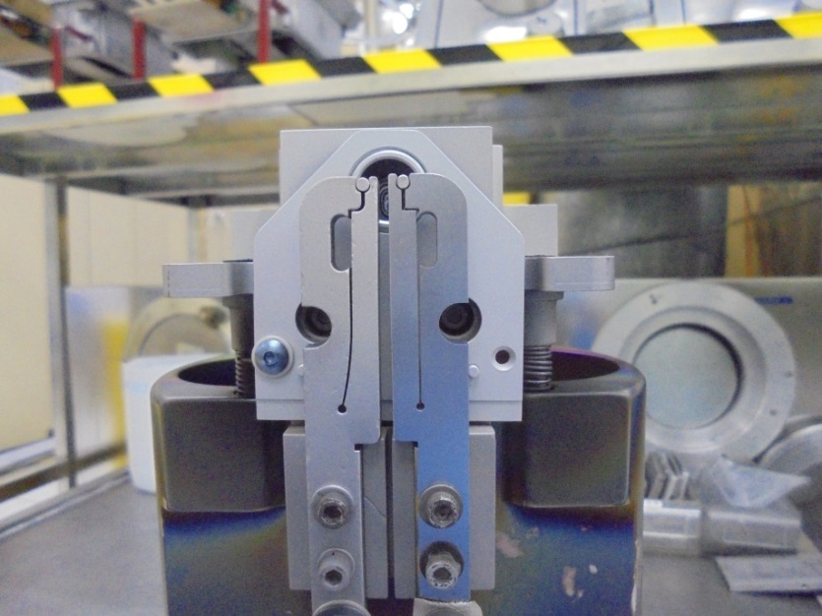
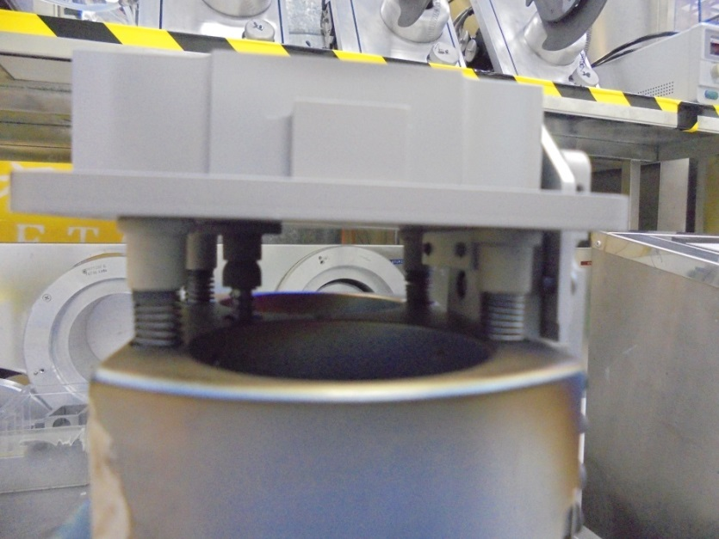
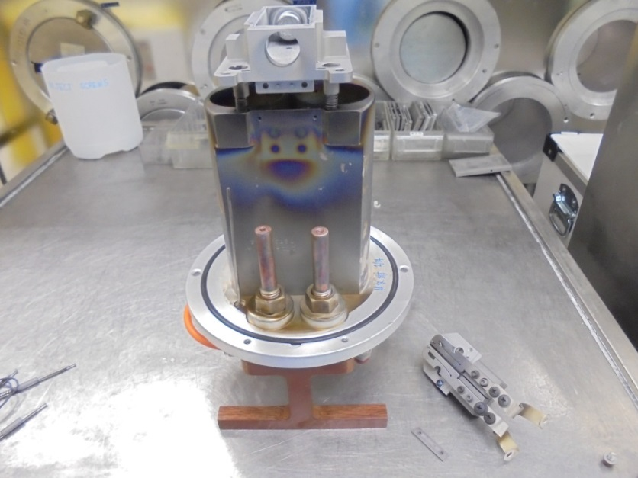
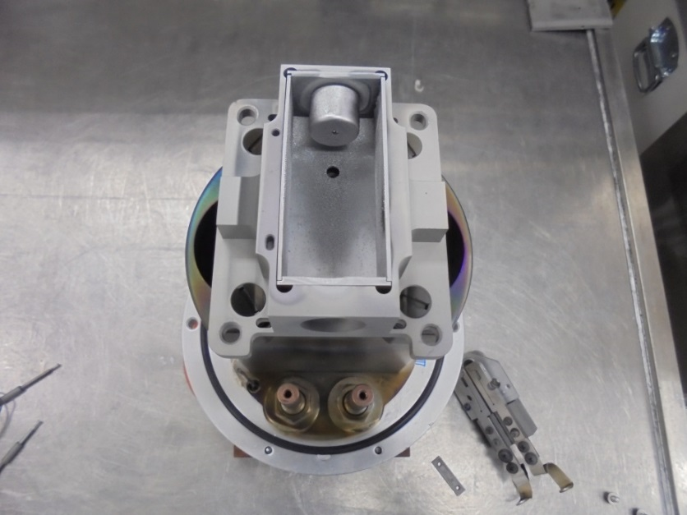
5
鬆開固定MOUNTING BLOCK的兩顆螺絲
MOUNTING BLOCK RETAINER SCREW
6
7
1
3
2
4
移除MOUNTING BLOCK ASSEMBLY
鬆開四根SHOULDER SCREW

Slide 6
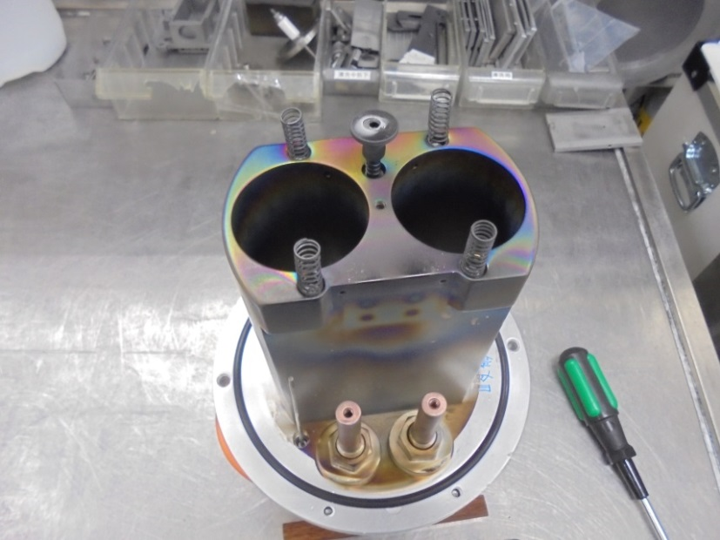
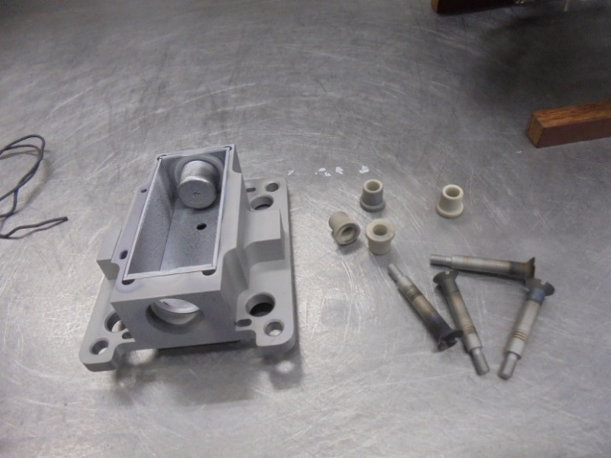
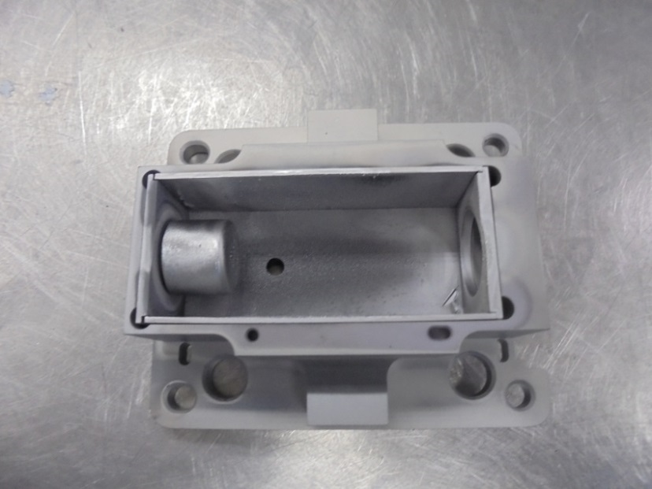
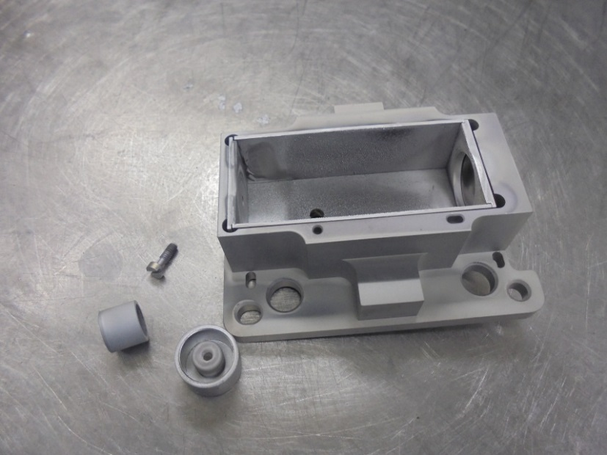
8
1
2
3
移除ARC CHAMBER
1. ARC CHAMBER 2. SPACER SCREW
3. SHOULDER SCREWS
9
10
移除REPELLER
移除BASE, SIDE, REPELLER and FILAMENT
PLATES LINER

Slide 7
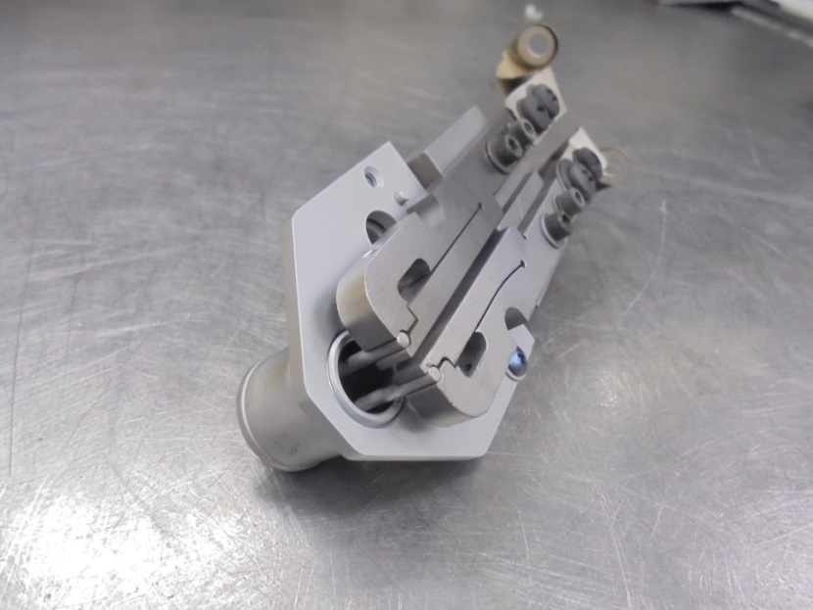
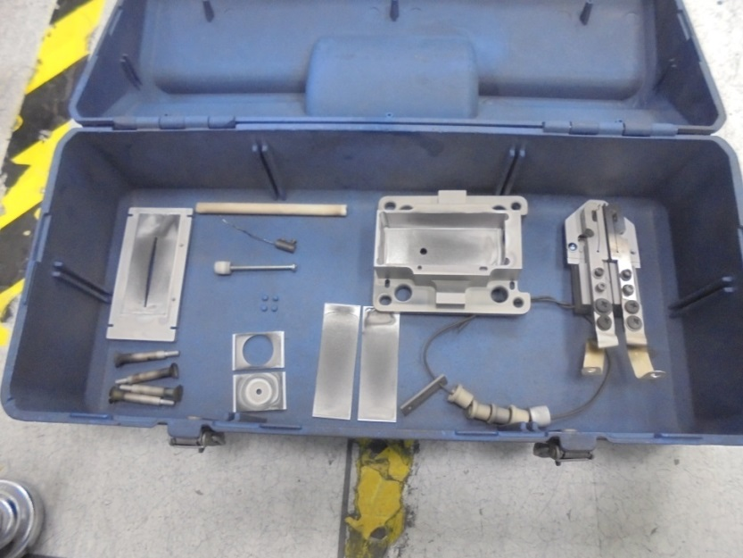
11
12
把CATHODE, CATHODE REPELLER 和 FILAMENT分解開來
拆下的零件帶去噴沙
CLEAN THE COMPONENTS IN SAND BLAST AREA
AIR SPRAY THE COMPONENTS TO REMOVE SAND RESIDUE
…WIPE CLEAN WITH IPA

Slide 8
ASSEMBLE
OF COMPONENTS

Slide 9
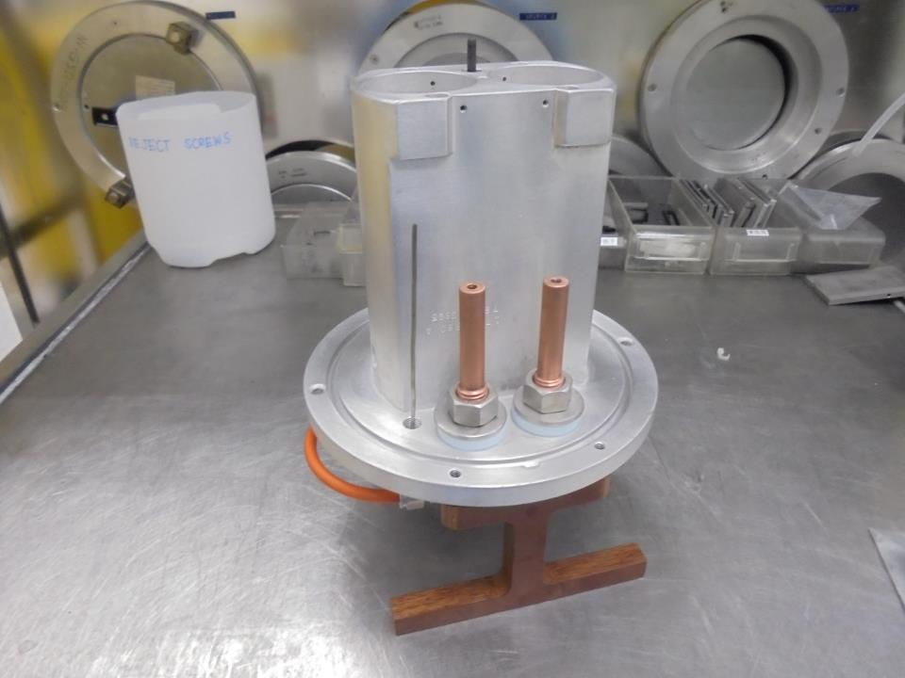
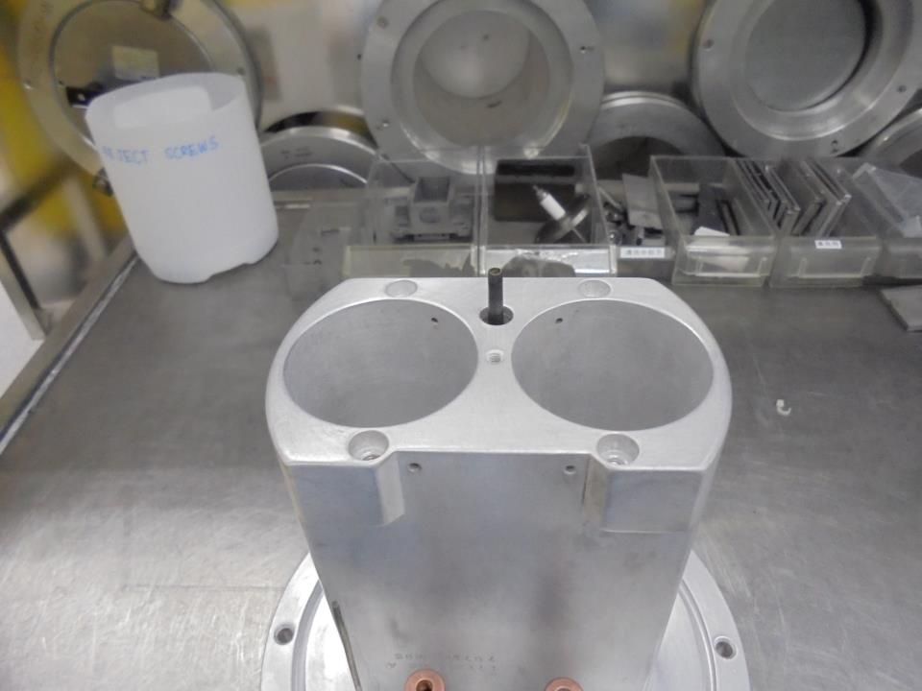
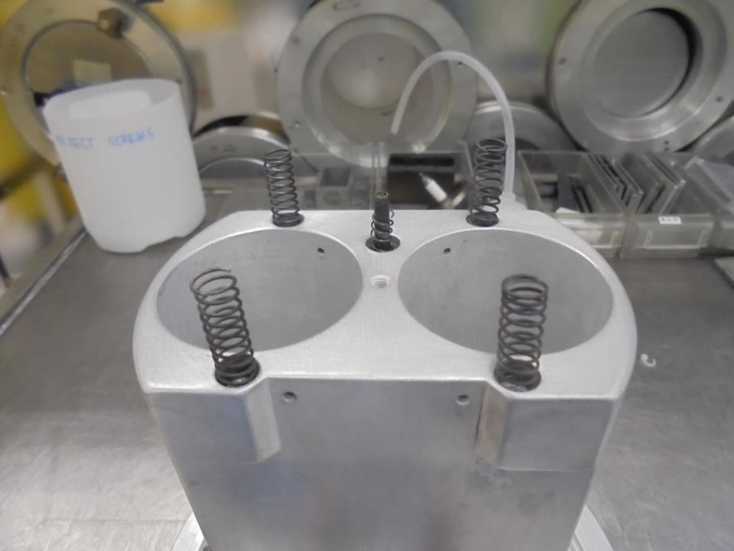
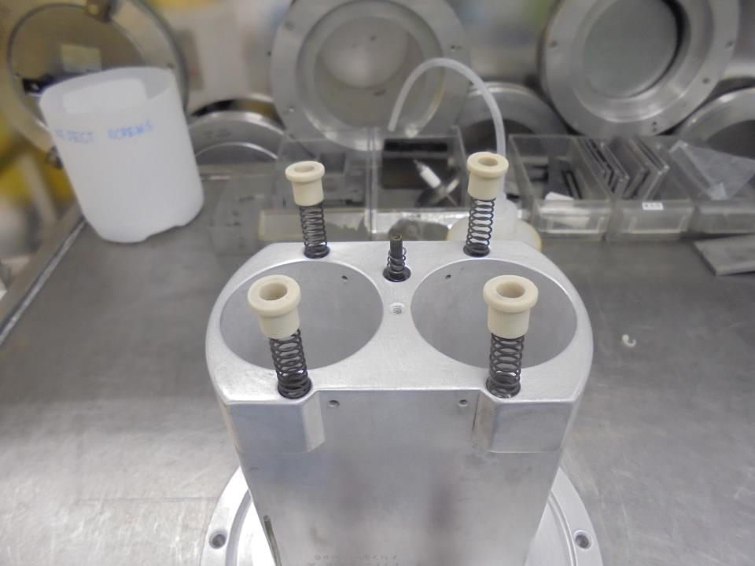



清理好的SOURCE BODY
TOP / MOUNTING SLOT
1
2
安裝SHOULDER SCREW SPRING
安裝CERAMIC SPACER

Slide 10
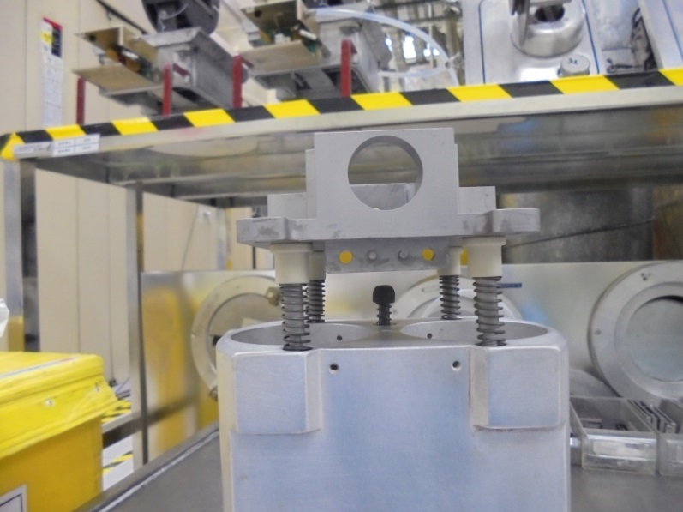
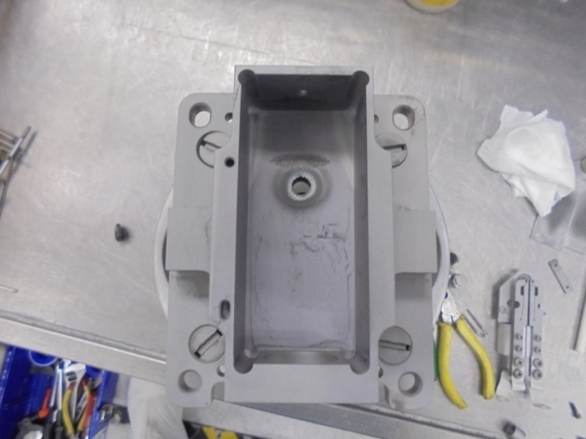



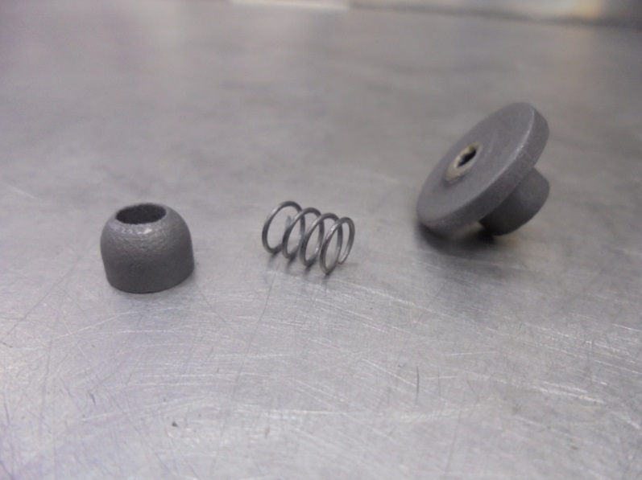
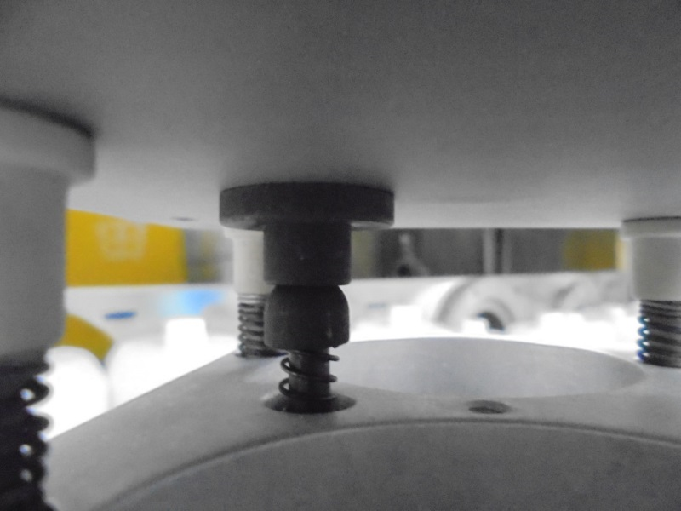

3
4
安裝ARC CHAMBER
安裝四個SHOULDER SCREW 暫時先不鎖緊
5
6
MUST BE NO GAP
安裝BALL JOINT, GAS SPRING, and SKT JOINT 在GAS LINE上
接著可以鎖緊四個SHOULDER SCREWS 確保ARC CHAMBER 跟SKT JOINT 沒間隙 以避免氣體外洩

Slide 11

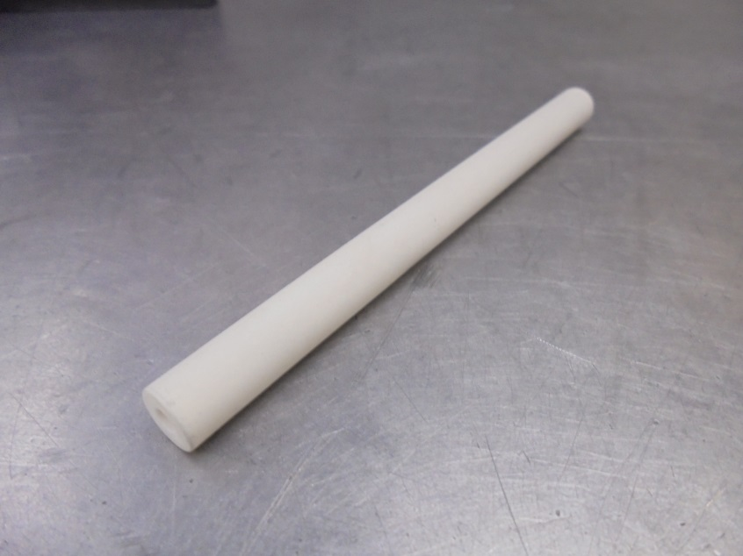
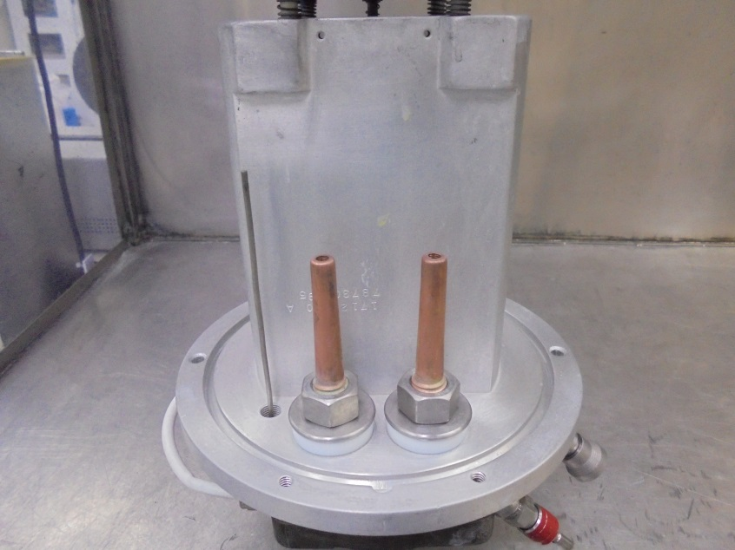

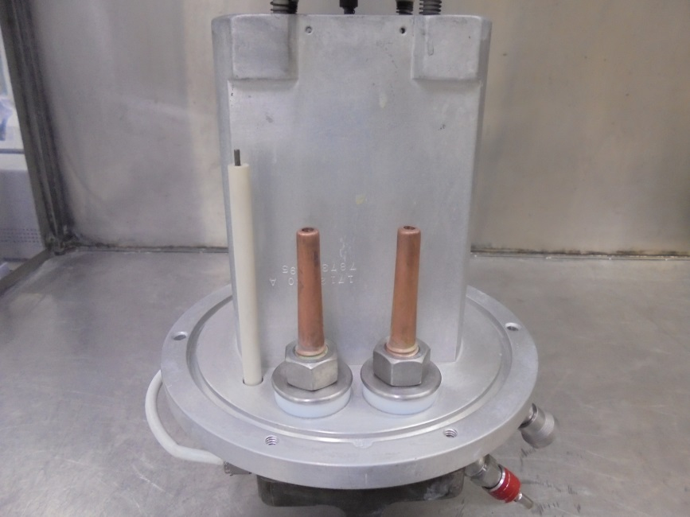
7
SUPPRESION LINE
安裝套在SUPPRESION LINE外的CERAMIC CATHODE TUBE

Slide 12
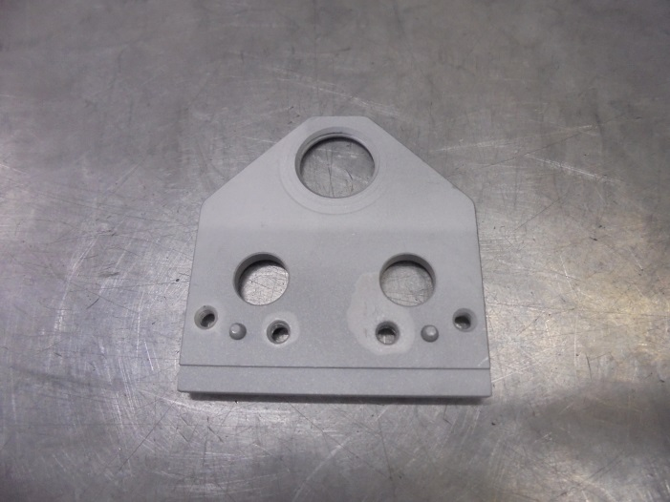
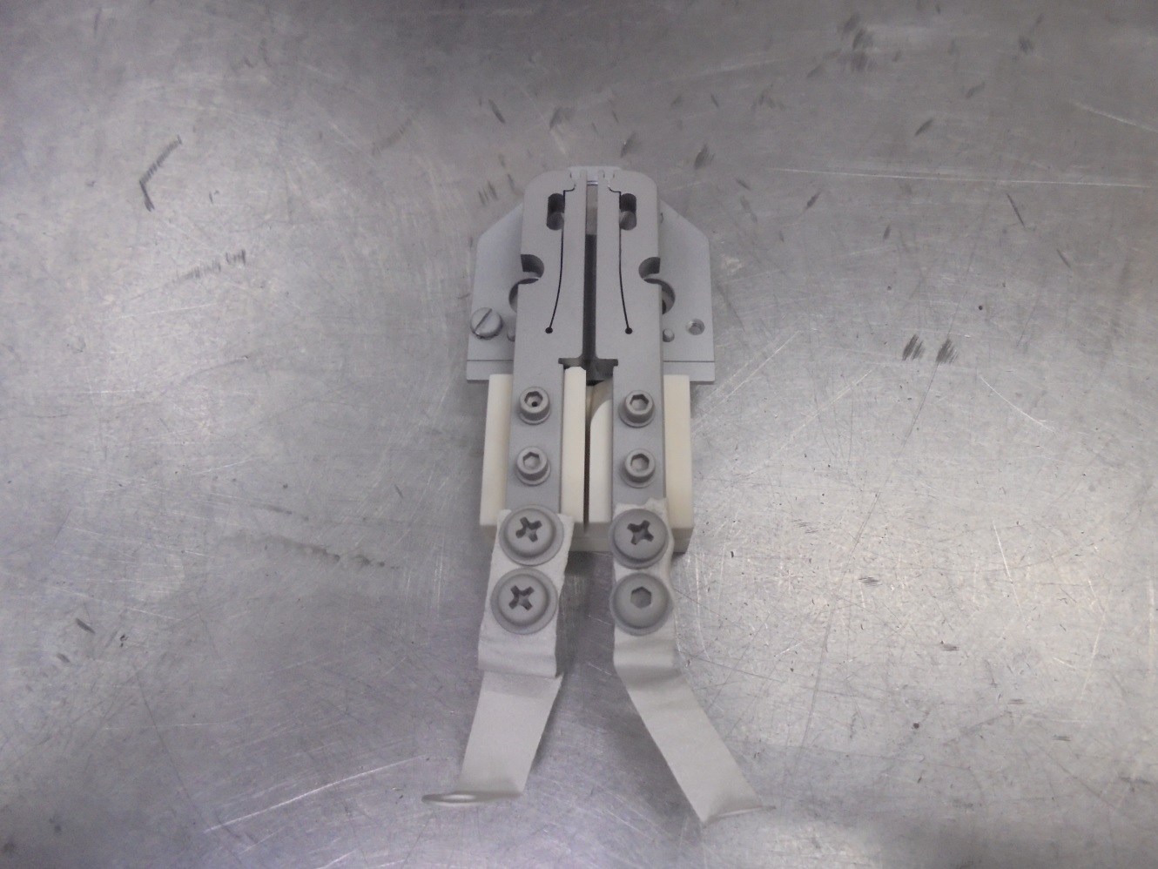
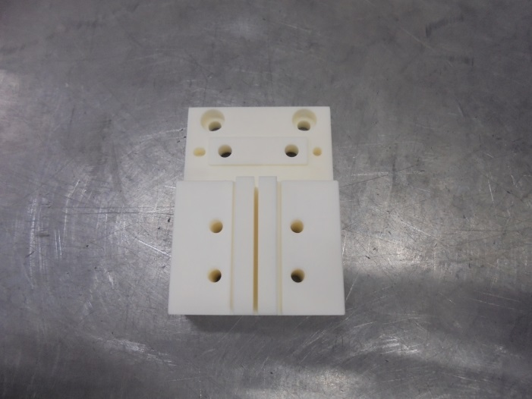
8
CATHODE SUPPORT PLATE
把MOUNTING BLOCK INSULATOR 、CATHODE SUPPORT PLATE、FILAMENT CLAMP 組裝在一起
MOUNTING BLOCK INSULATOR

Slide 13
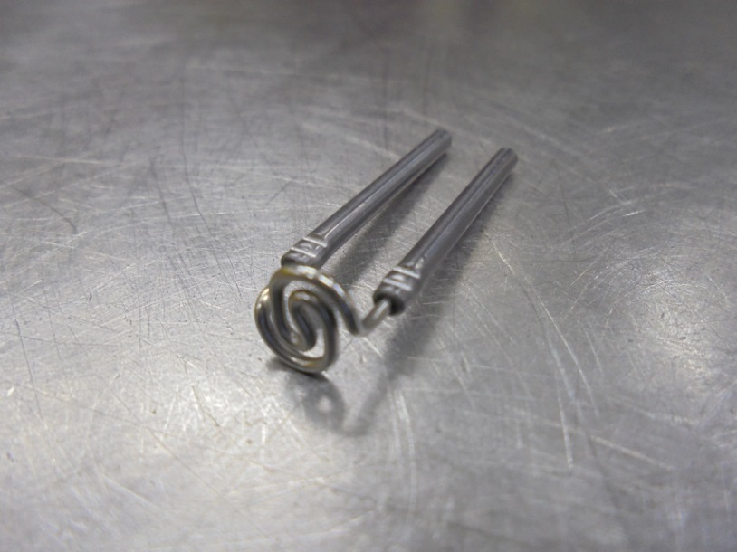
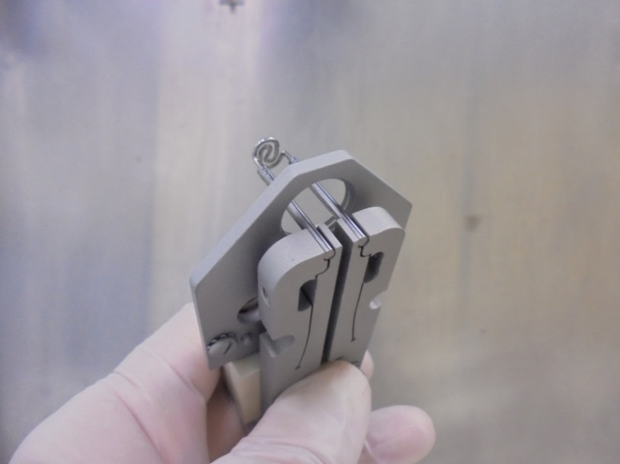

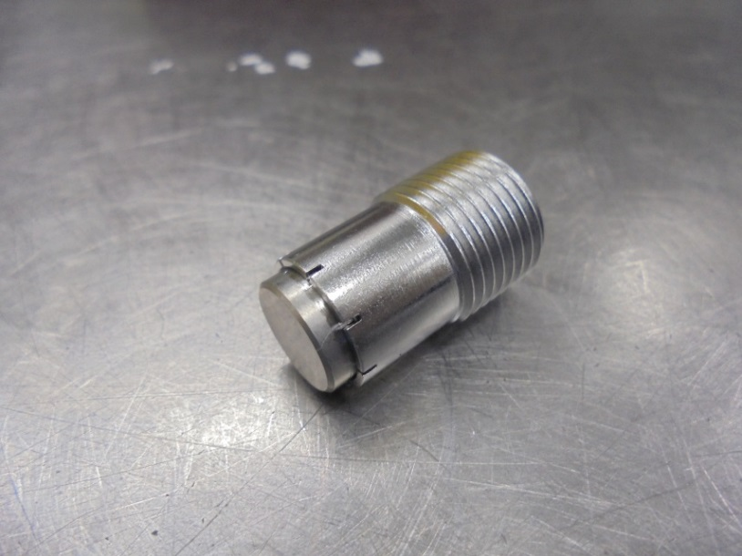
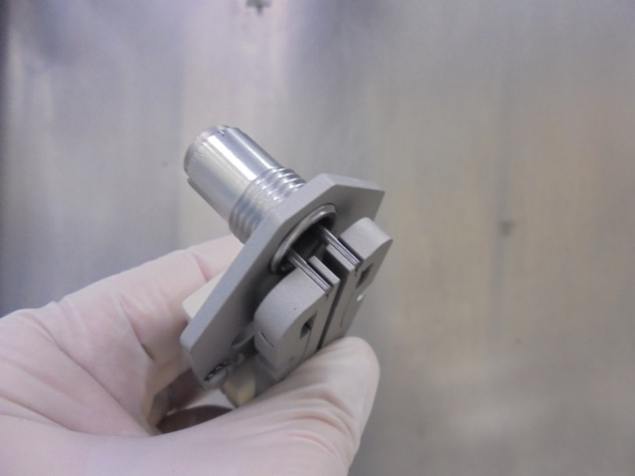
9
把FILAMENT CLAMP撐開以夾住ELS FILAMENT
10
把CATHODE裝到CATHODE SUPPORT PLATE上
CATHODE碰到ELS FILAMENT 後 轉出3/4圈

Slide 14
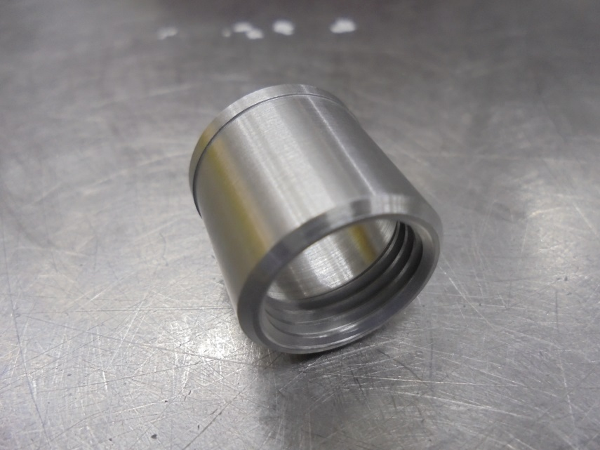
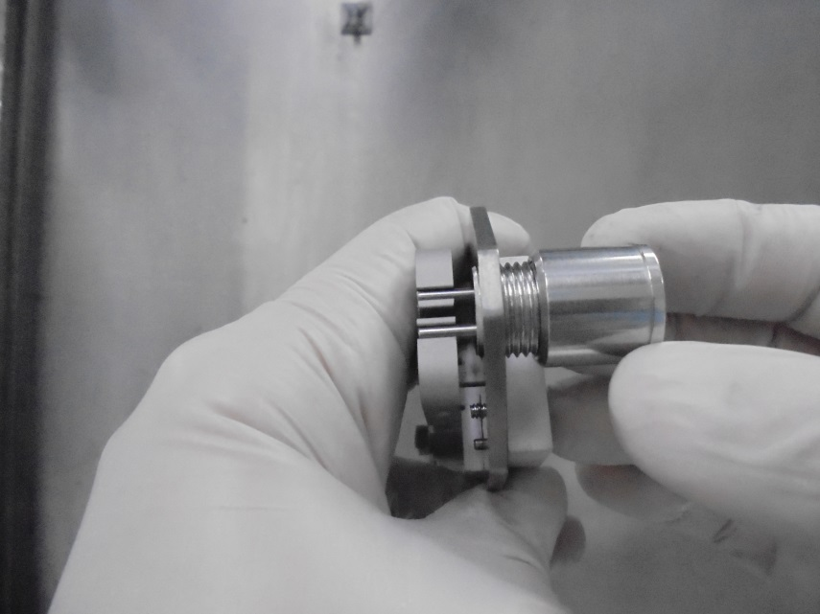
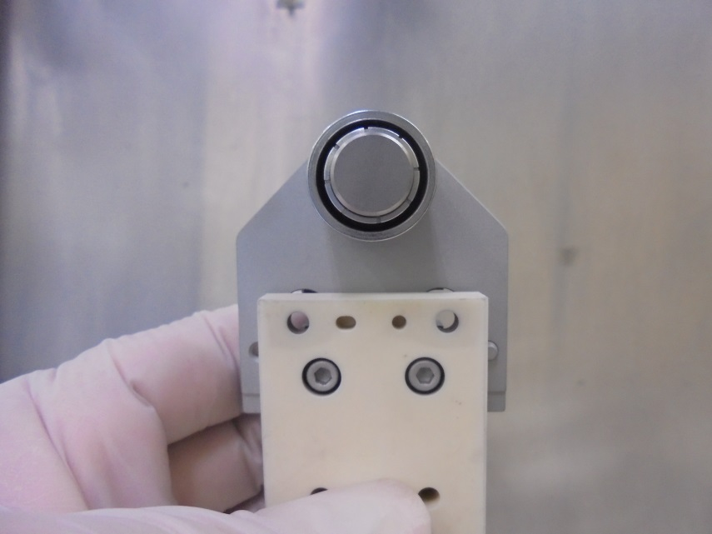
11
把CATHODE REPELLER裝到CATHODE上
暫時不鎖緊

Slide 15
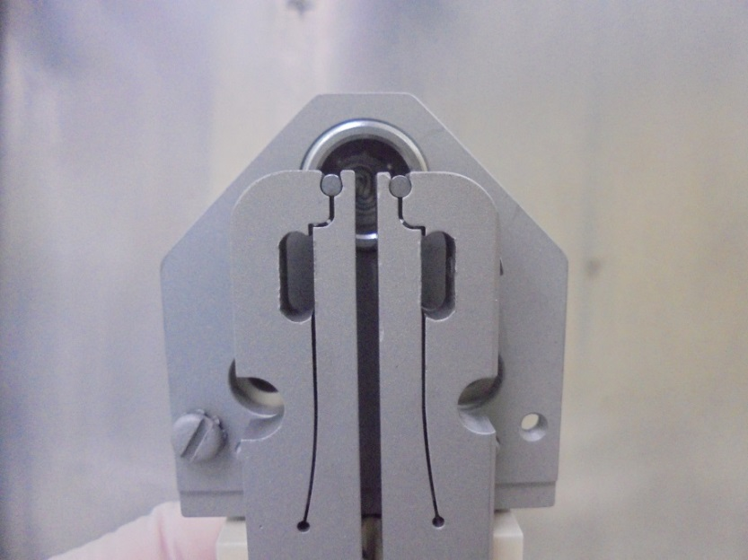
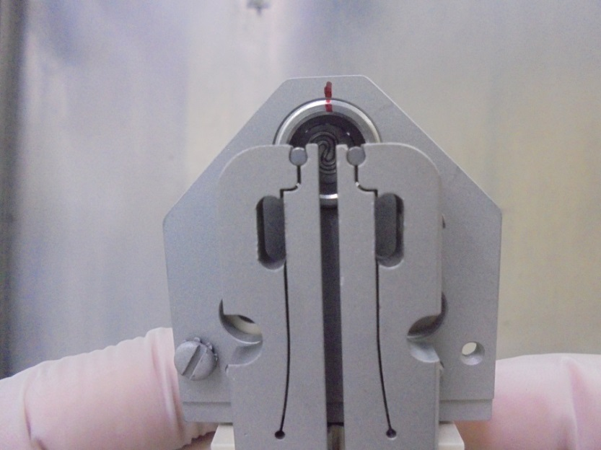

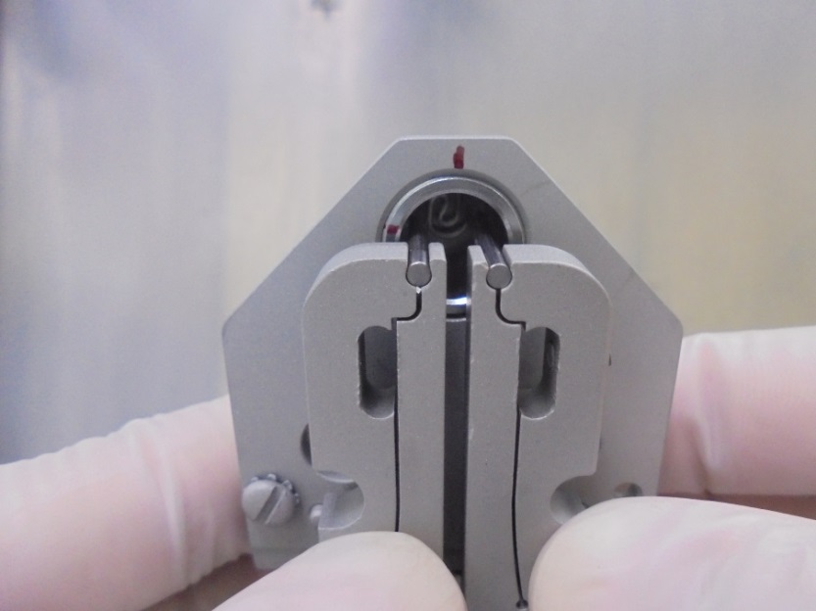
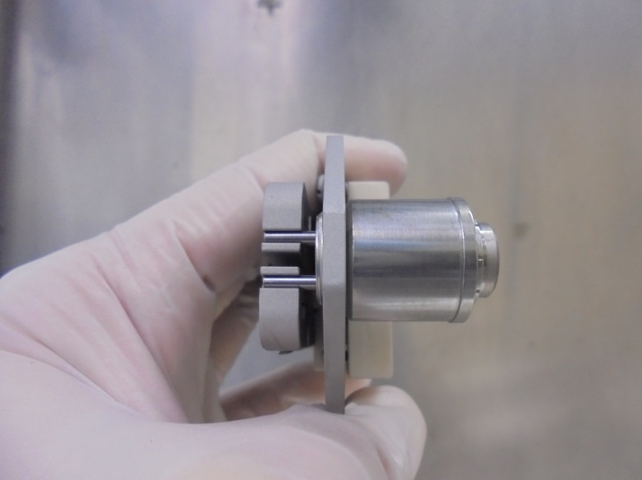
12
13
確認FILAMENT 在CATHODE WALL內且與四周等距離沒有接觸
標記CATHODE SUPPORT PLATE 與CATHODE 位子(FILAMENT跟CATHODE剛好碰到時)
14
15
轉出CATHODE 3/4圈
這時可以將CATHODE REPELLER鎖緊

Slide 16
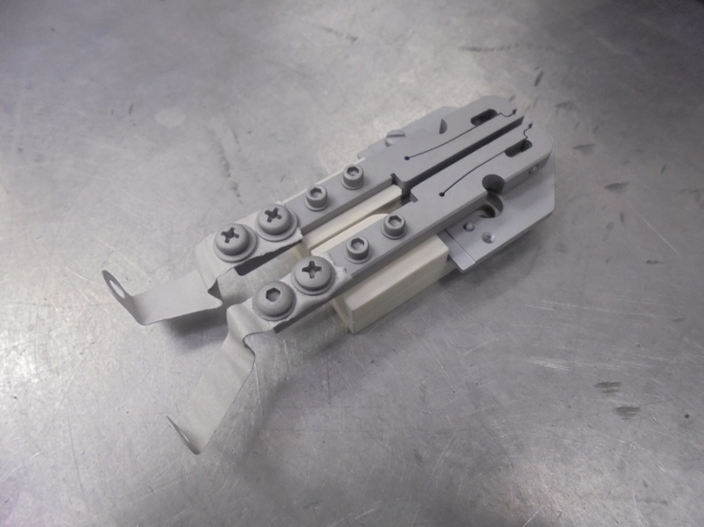
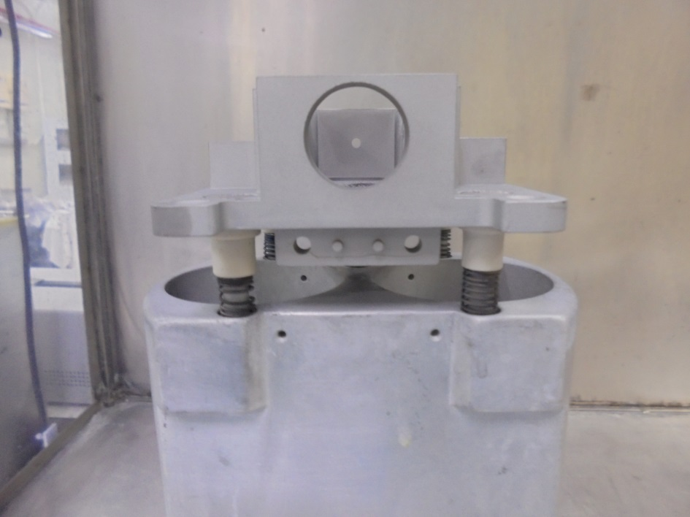

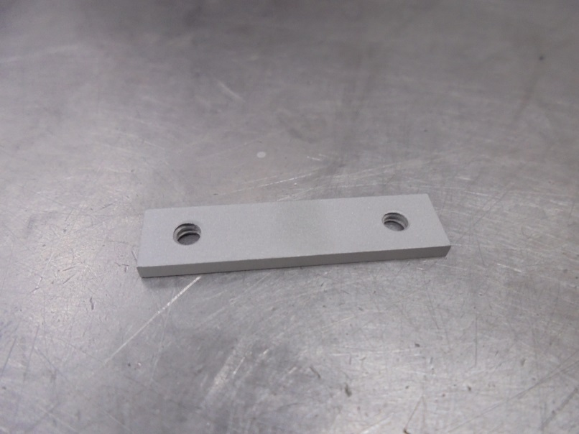
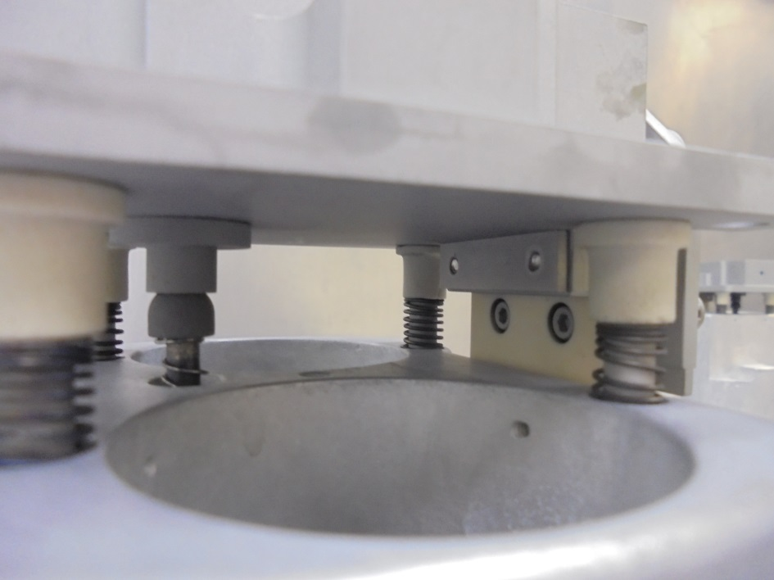
16
將MOUNTING BLOCK 部件安裝到 ARC CHAMBER上
HERE!
17
HERE!
螺絲將MOUNTING BLOCK SCREW RETAINER、ARC CHAMBER 、MOUNTING BLOCK 三者鎖在一起固定

Slide 17
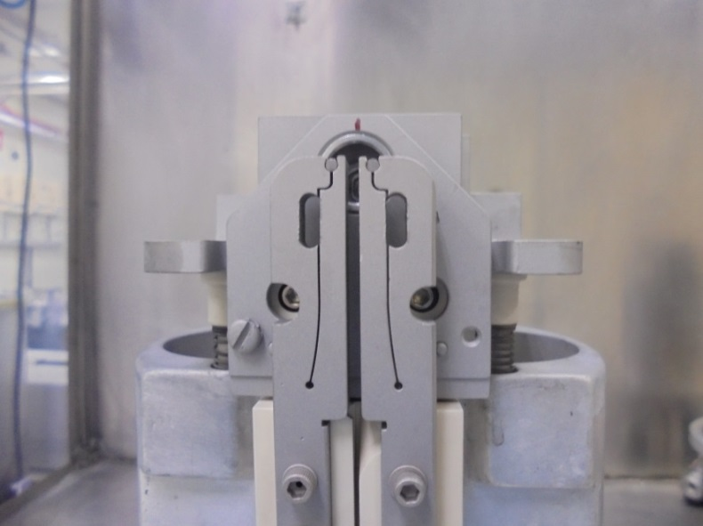
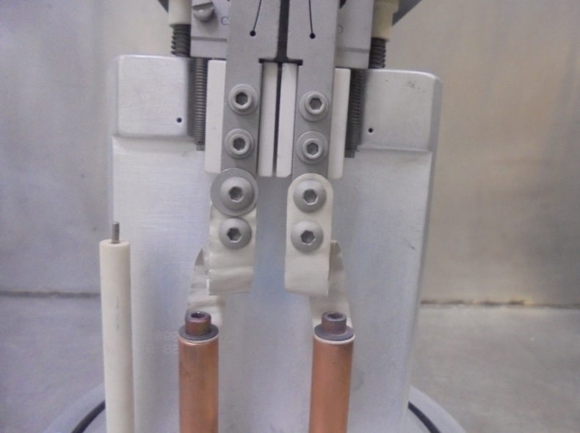
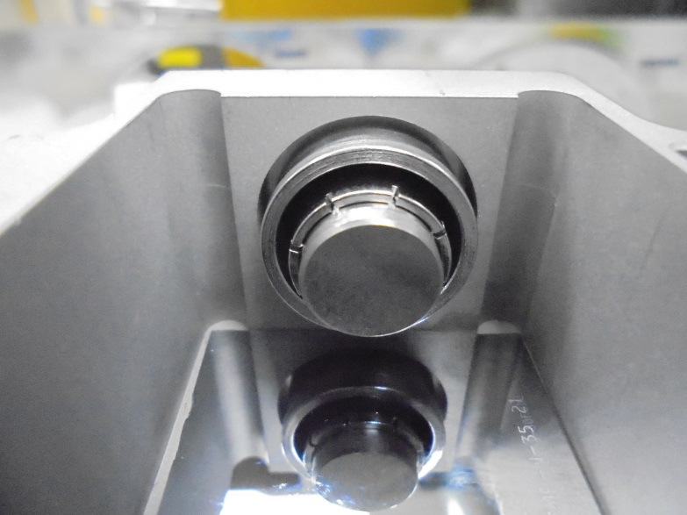
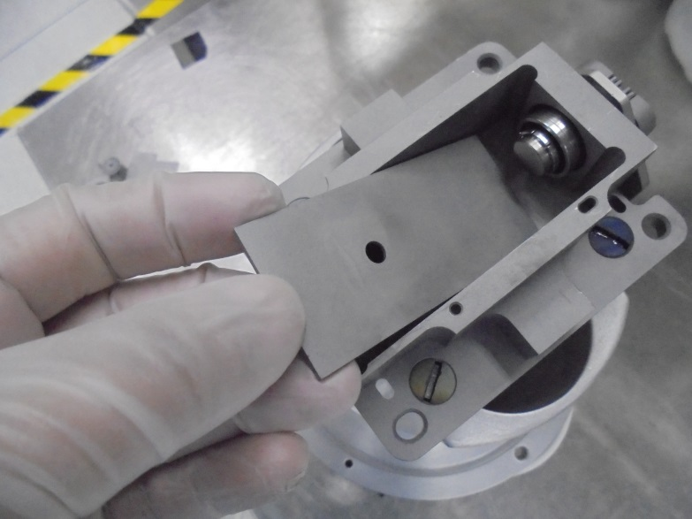
18
確保螺絲都有鎖緊
確保螺絲都有鎖緊
19
20
用鏡子檢查或是看兩側與上面間距是否一致即可知道位置是否置中
確保CATHODE在ARC CHAMBER WALL裡置中位子
安裝BASE PLATE LINER

Slide 18
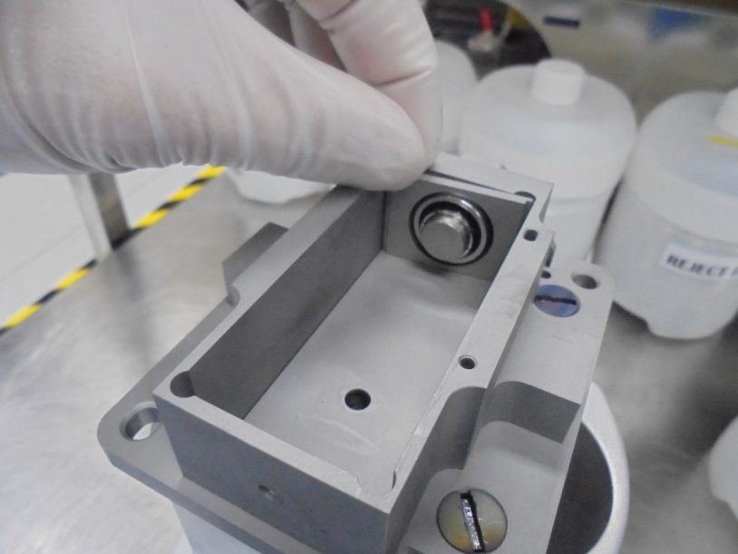
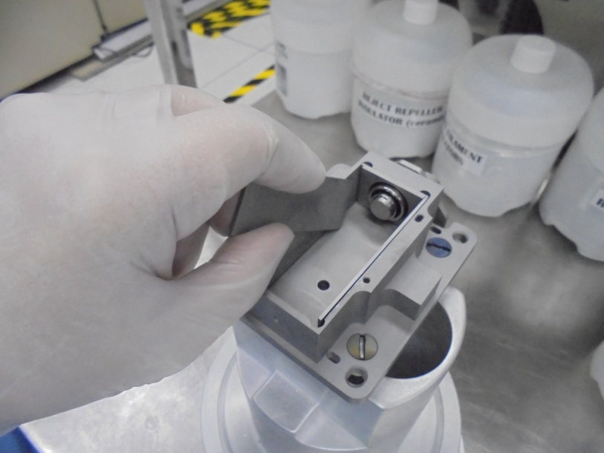


21
22
安裝FILAMENT PLATE LINER
安裝SIDE PLATES LINER
23
24
安裝REPELLER END PLATE LINER
組裝REPELLER 部件

Slide 19




25
26
確保REPELLER有鎖緊
重複確認ARC CHAMBER裡的零件是否有裝好
27
28
安裝CATHODE CONNECTOR跟WIRE
確保CONNECTION兩端都有鎖緊固定好

Slide 20
ISOLATION TEST

Slide 21




1
2
FILAMENT需要導通
FILAMENT LINE跟SOURCE BODY需要絕緣
3
4
REPELLER跟ARC CHAMBER需要絕緣
SUPPRESSION LINE跟CATHODE SUPPORT PLATE需要導通

Slide 22



5
6
SOURCE BODY跟CATHODE SUPPORT PLATE需要絕緣
CAHODE SUPPORT PLATE跟FILAMENT CLAMP需要絕緣
7
ARC CHAMBER跟CATHODE SUPPORT PLATE需要絕緣

Slide 23




29
安裝ARC SLIT
30
用RETAINER PIN固定ARC SLIT

Slide 24



31
32
用IPA清理O-RING 溝槽
確認O-RING無損傷以免影響漏率
用IPA清理並塗上VACUUM GREASE裝上
33
簽上組裝人名字跟組裝日期

